Slide 1




Methodology: America’s Greatest Midsize Workplaces 2025
New York
February 2025

Slide 2
From Newsweek’s Global Editor in Chief
In today's corporate landscape, diversity is a widely discussed topic. Employers highlight their commitment to recruiting and advancing individuals of various ages, races, genders, sexual orientations and abilities. Companies recognize that a diverse workforce contributes significantly to organizational success. Diverse workforces cultivate creativity and innovation that stem from a mix of perspectives, experiences, and backgrounds, fostering a dynamic environment where new ideas come to life.
While the attention on diversity has surged among companies, it can be challenging for job seekers, customers and potential partners to discern which organizations are genuinely dedicated to supporting a diverse workforce. In response, Newsweek and market data research firm Plant-A Insights Group are proud to present, for the first year, America's Greatest Mid Size Workplaces 2025, featuring the top Midsize Workplaces recognized by their employees for genuinely respecting and valuing individuals from different walks of life.
Global Editor in Chief

Slide 3







Leading the Way in Workplace Excellence: Unveiling America’s Greatest Midsize Workplaces 2025
"America’s Greatest Midsize Workplaces 2025" honors the top Midsized companies in the United States based on their performance across key workplace-related categories.
Our study involved a comprehensive analysis of over 3.5 million online employee reviews, along with publicly available data for 9,000 companies employing between 500 and 1,000 individuals. This thorough evaluation aimed to assess key factors contributing to workplace performance and employee satisfaction. We conducted a survey to understand the importance for each key workplace-related category and created a model to factor in industry deviation scores.
Newsweek and Plant-A Insights Group has partnered to determine America’s Greatest Midsize Workplaces 2025.
We collaborated with a third-party data provider, Aniline, to leverage their extensive database of over 120 key performance indicators (KPIs) for U.S.-based companies. These KPIs cover a wide range of crucial factors, including Leadership, Integrity, Compensation, Career Development, Culture & Belonging, and Work-Life Balance, offering a comprehensive view of workplace performance and employee satisfaction.

Slide 4





Methodology: America’s Greatest Midsize Workplaces 2025 step by step
The Study consists of 5 parts
1
Category Score
We partnered with Aniline, a platform that provides real-time workforce insights, to utilize their extensive database of over 120 KPIs across more than 70,000 companies. These KPIs cover essential areas such as Leadership, Integrity, Compensation, Work-Life Balance, Culture & Belonging, Career Development, and Work Environment.
2
Survey
We conducted a survey and collected over 3.5 million employee reviews to identify the importance of key workforce-related categories. Based on these insights, we assigned weights to each category, which were then combined with the category scores to calculate a final weighted score, reflecting the relative importance of each category.
3
Industry deviations
For each industry, we computed an average category score using an industry deviation model. We then applied industry deviation scores to develop an additional metric that highlights a company’s performance compared to the industry average in each workforce-related category. A score is assigned based on these relative deviations.
4
Media Monitoring
The Critical Mention media monitoring platform from Onclusive was utilized to investigate whether employers were implicated in unfair workplace practices and/or reported for workplace harassment within the last two years (February, 11 2023 – February 11, 2025). Any employers found engaging in such practices were subsequently excluded from the final ranking list. Newsweek and Plant-A Insights conducted multiple iterations of the media monitoring process to validate the exclusions and ensure the accuracy of the results.
5
Data Validation & Final Ranking
The validation process introduces an additional layer of scrutiny to the results. A collaborative effort involving the Plant-A research and Newsweek editorial teams meticulously reviewed all outcomes for plausibility. Adjustments to the study results were exclusively made in cases where a discrepancy existed between the experts' assessment and the ranking, provided that their reasoning could be verified.
Utilizing our proprietary scoring model (refer to the scoring model slide), we calculated a project score for each company, considering all relevant weights on various categories. We calculated a total score for each company based on the scoring model. The quality of companies that are not included in the ranking is not disputed.

Slide 5




America’s Greatest Midsize Workplaces 2025 is based on >3.5 million opinions for more than 5,400 qualified companies
1
Scoping
2
Category scoring
3
Weight assessment Survey
4
Industry Deviation
5
Media Monitoring & Validation
Analyzed 3.5 million data points recorded in the last 24 months, categorized workplace elements into broader categories, and shortlisted 5,400 companies
Qualifying Criteria:
500-1000 employees
US Headquartered with a minimum of 100 employee opinions
Secondary Data: Leverage Aniline database of 120+ KPIs from over 70,000 companies, covering key workforce-related categories
Working Environment
Work-Life Balance
Career Progression & Training
Company Culture
Compensation & Benefits
Culture & Belonging
Survey: Analyzed over 400K employee reviews collected over 3 years to identify the importance of key workforce-related categories and assigned weights to each based on their influence on employee sentiment
Created an industry deviation model reflecting individual performance relative to the industry average in each workforce category.
Employers implicated in unfair practices or harassment within the last two years were excluded from the final ranking, with multiple validation steps ensuring reliability.
50%
50%
Total Score
=
Category score points
X
Category Weight
+
Industry Deviation Score
Final Score = 0.5 x ∑w . S + 0.5 x ∑w . D
i
i
i
i
i
i
Note: w = Weight of category i, S = Category score for category i, D = Industry deviation category score for category i
i
i
i

Slide 6






Core Workplace Factors Shaping Employee Sentiment
Working Environment
Work-Life Balance
Safety/Physical Environment
Teamwork
Communication
Tools & Productivity
Location
Leadership
Flexibility
General Work-life
Workload
Duties
Remote work
Essential workplace-related categories that drives employee sentiment
Career Progression & Training
Culture & Belonging
Fairness
Sense of Belonging
Equal Growth Opportunities
Workforce Representation
Career Opportunity
Individual Contribution
Training & Development
Mobility
Compensation & Benefits
Company Culture
Welfare Design
Market Adequacy
Performance Related
Mission
Vision
Honesty
Commitment

Slide 7
Review and Evaluation
Media Monitoring
For our media monitoring project, we utilized the tool Critical Mention a Onclusive Company. Onclusive is a world leader in media intelligence technology and services dedicated to supporting PR, Communications, and Marketing professionals.
Discrimination / Harassment: Utilizing Critical Mention to ensure that there are no pervasive public allegations.
Workplace Conditions: Verify that there are no pervasive public lawsuits.
Sustainability: Verify that there is public information about ongoing positive environmental engagement.
We used a variety of keywords to screen the press coverage of the last 24 months (February 11, 2023 – February 11, 2025).
Data Validation & Final Ranking
The final rankings were calculated based on Plant-A’s scoring model and study approach.
The companies with the highest scores in the employee tier 500 employees to 1,000 employees were recognized as America’s Greatest Midsize Workplaces 2025.
Plausibility check. Newsweek and Plant-A have reviewed all results and lists before publishing to avoid errors and add an additional layer of scrutiny.

Slide 8




Companies will be grouped into 56 industries
Ranking
Financial Services and Business Services
Energy, Resources and Industrials
Appliances, Electrical, and Electronics Manufacturing
Machinery Manufacturing
Food and beverage Manufacturing
Chemical Manufacturing
Civil Engineering
Utilities
Pharmaceutical and Medical Equipment Manufacturing
Mining, Oil and Gas
Electrical Power Transmission, Control and Distribution
Automotive
Motor Vehicle Manufacturing
Farming and Horticulture
Furniture and Home Furniture Manufacturing
Engineering Services
Professional Services
IT Services and IT Consulting
Banking
Insurance
Accounting
Non-Profit Organizations
Individual and Family Services
Financial Services
Research Services
Transportation, Logistics, Supply Chain and Storage
Transportation
Aviation and Aerospace
Food and Beverage Services
Business Consulting and Services
Facility Services
Staffing and Recruiting
Warehousing and Storage
Security and Investigations
Maritime Transportation
Environmental Services
Truck Transportation
Consumer Services
Retail
Wholesale
Mental Health Care
Medical Practices
Legal
Wholesale Building Materials
Wellness and Fitness Services
Hospitality
Construction
Repair and Maintenance
Real Estate
Civic and Social Organizations
Museums, Botanical Gardens, and Zoos
Printing and Photography
Entertainment Providers
Education
Hospital and Healthcare
Technology, Media and Telecom
Software Development
Technology, Information and Internet
Media
Telecommunications

Slide 9







Your Company is on the list? Great job, and Congratulations! Utilize your performance and license the badge.
Examples on how companies use recognitions
Email Footer
Recruiting Pages
Homepage
Videos & Presentation
Social Media
Media & Press Kit
Questions about the project and licensing opportunities?
Use Newsweek's America’s Greatest Midsize Workplaces Logo for your corporate e-mail signatures to showcase your company's
achievement to
Clients
Applicants Customers
Business partners and many more.
Use Newsweek's America’s Greatest Midsize Workplaces Logo for your:
Recruitment pages
Job offers
And company profiles
To convince applicants, prospects and
stakeholders to become
a part of your company and work culture.
Use Newsweek's America’s Greatest Midsize Workplaces Logo for your company homepage to showcase our achievement to
Investors
Clients
Applicants
Customers
Partners
Use Newsweek's America’s Greatest Midsize Workplaces Logo for:
Television Ads NPR and Podcasts
VOD
Presenta-tions
In order to reach your target group, the best possible way
Use Newsweek's America’s Greatest Midsize Workplaces Logo on your social media profiles
Instagram
YouTube
Twitter
Facebook
Use Newsweek's America’s Greatest Midsize Workplaces Logo for company press releases and media kits to :
Increase awareness
Achieve higher accessibility
Show the impact on work culture of your company
Inquiries about licensing and pricing:
Licensing@plant-a.com
or
Americas.Greatest.Workplaces@Newsweek.com
Inquiries about the study / individual analysis
Research@plant-a.com

Slide 10
Imprint
Plant-A Insights Group LLC
For any questions and requests:
Contact@plant-a.com
Authors: Plant-A Insights Group
Sources & Partner U.S. census 2024, Company websites, Aniline, various news outlets, various Social Media platforms, Onclusive, Critical Mention an Onclusive Company
Image rights: iStock

Slide 11
Disclaimer
Rankings Placement
Placement in the Rankings (defined below) is a positive recognition based on research of publicly available data sources from the time period in question.
Intellectual Property Rights All content within the rankings ("Rankings") is the exclusive property of Plant-A Insights Group LLC (“Plant-A”). This work, including all data, analyses, and derived rankings, is copyrighted under United States and international copyright laws. Unauthorized use, including but not limited to the publication, reproduction, modification, distribution, transmission, or display of any material without the prior written consent of Plant-A, is strictly prohibited.
Nature of the Rankings The Rankings are prepared by Plant-A and reflect an editorial content piece, based on both primary and secondary market research. This includes publicly available data and specific data provided directly to Plant-A. These Rankings are published in conjunction with Newsweek and should be viewed as an editorial work, not as definitive financial or business guidance.
Data Accuracy and Periodicity The Rankings are generated from data sources deemed reliable and are formed based on a methodological analysis of such data spanning the last 24 months. They are inherently a reflection of historical data and may not include subsequent developments, unforeseen events, or additional data not covered during the research period.
No Endorsement or Quality Assurance Plant-A does not endorse nor validate the business practices or the standing of the ranked companies. The inclusion or exclusion of any company in the Rankings should not be used as a basis for investment, business, or other decisions. All decisions based on any information presented in the Rankings should be made in conjunction with other available information and independent advice.
Disclaimer of Liability Plant-A, its subsidiaries, and their respective officers, directors, employees, and agents (collectively, the "Plant-A Parties") disclaim all liability and responsibility for any errors or omissions in the Rankings or for any actions taken based on the contents of this publication. Neither Plant-A nor Newsweek guarantees the completeness or accuracy of the information contained in the Rankings.
By accessing, using, or relying upon the Rankings, you waive all claims and have no recourse against Plant-A Parties for any alleged or actual infringements of any rights of any party, including privacy rights, proprietary rights, intellectual property rights, rights of publicity, rights of credit for material or ideas, or any other rights, including the right to approval of uses such as copy that may be deemed to be distorted, derogatory, or offensive.
This disclaimer is intended to be as broad and inclusive as permitted under the law. If any portion hereof is held invalid or unenforceable, the remainder of the disclaimer shall nonetheless remain in full force and effect. This disclaimer constitutes the entire agreement between you and Plant-A regarding the use of the Rankings.
Copyright © 2025 Plant-A Insights Group LLC. All rights reserved.

Slide 12
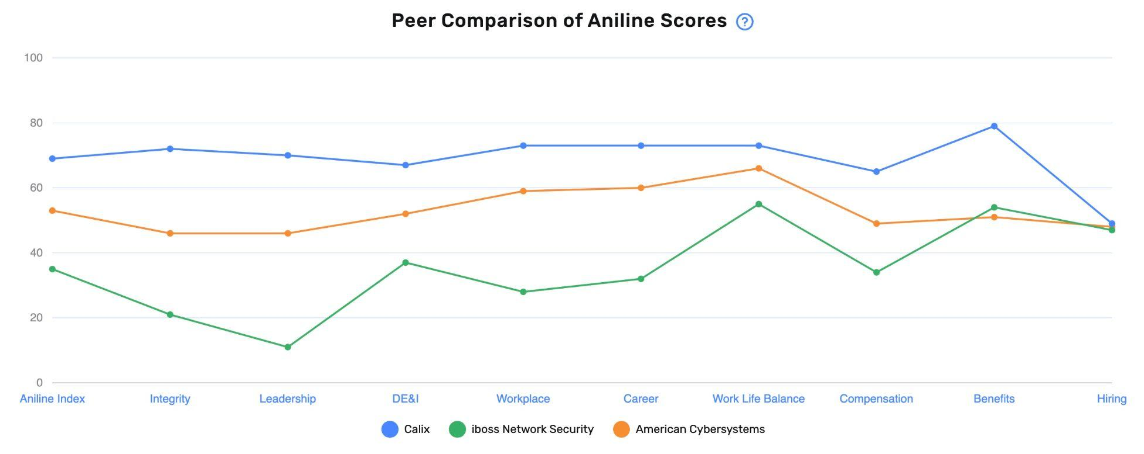
Aniline simplifies listening technology.
We turn Voices into Value.
How do you stack up?
Real-time workforce insights reveal employee experiences across 70,000+ companies, empowering you to make informed decisions, seize opportunities, and drive impactful change.
Improve Outcomes
Automated root-cause analysis of turnover, productivity, and more
Reduce Risk
Enhance employer brand & reputation, powered by Gen AI
Culture Drivers
Identify real-time employee pain points to build a stronger organizational culture
Optimize Strategy
Develop effective change management strategies

Slide 13
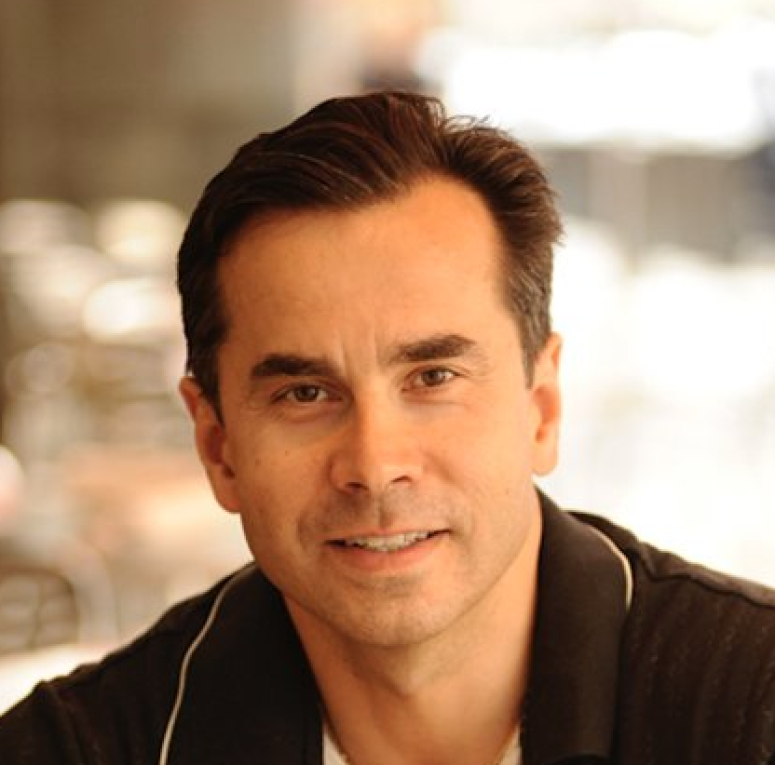









Who are we?
70K+
Published companies
1B
Employee data points
62K+
Private companies, Education & NPOs
1M
Reviews added per month
Trusted by Industry Giants
Visit us at www.aniline.ai
Igor Karpovich
Chief Revenue Officer
igor.karpovich@aniline.ai
James Marple
Chief Experience Officer
james@aniline.ai

Slide 14


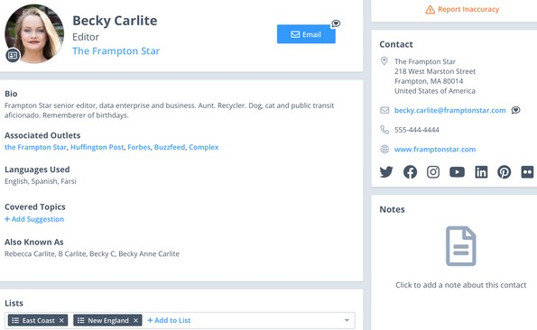
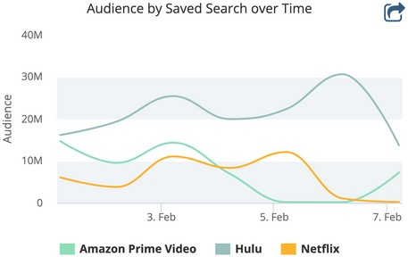

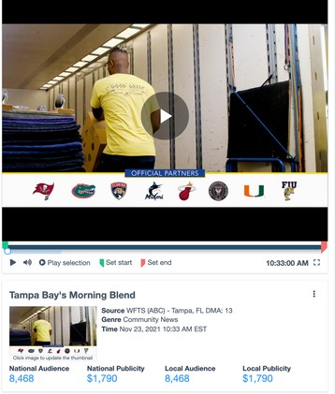
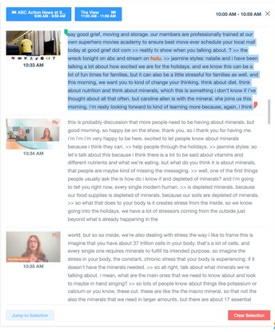






1
Promotion
Leading Technology
Easily access news coverage and media contacts information.
Overview 2022
Leverage our leading capture network to get more coverage in the U.S. & Canada than with any other provider
T R A C K . M E A S U R E . S H A R E . G R O W .
Get insights that matter with an intuitive, mobile-friendly interface and unlimited ad-hoc searching across TV, radio, online news, social media, licensed content (behind paywalls) and podcasts
Automate everyday tasks with saved searches, real-time alerts, & email digests
The Critical Mention Earned Media
Suite includes the fastest, most reliable real-time media monitoring tools,
robust analytics and most accurate
and frequently updated media contact database in the industry.
PR and communications pros use Critical
Mention to track, measure, share and grow earned media coverage. Monitor all of your mentions in real-time across TV, radio, online news, licensed content, podcasts, YouTube,
Twitter, Instagram and Facebook to get a clear picture of your coverage. Build
customized reports with analytics such as
share of voice, geographic coverage trends, mentions over time, sentiment analysis, publicity values and Google Analytics data and charts integrated into the platform.
Access more than a million records with Critical Mention's Media
Contact Database, including social media profiles and pitching
information for reporters,
bloggers, producers, editors and social media influencers. Looking for the best support in the
industry? Your dedicated account manager is on call 24/7/365.
Utilize the media contact database to target journalists by location/designated market area (powered by Google), topic data, job title and more
2
Instant Sharing
Direct links from the Media Contact Database to contact's recent Broadcast and Online News stories
Download HD broadcast and YouTube clips, and podcast clips in real-time
Use our Wordplay technology to refine HD broadcast and podcast clips down to the micro-second
Take advantage of unlimited cloud storage to save important coverage you can revisit at any time
40
2K
Global TV and radio sources; more content in the U.S. and Canada than anyother provider
HOURS
Video content captured every minute
Licensed content, online
newspaper, magazine, trade publications, forum and blog pages
Comprehensive coverage of
the leading social media platforms
Get access to 1+ million records and pitching information
Access text transcription and edit clips of
top podcast mentions
This week alone , Critical Mention's monitoring has saved my team twice by providing lightning-fast alerts on some important news we were waiting for.
- Caroline Coons, Jelly Marketing
212.398.1141 www.criticalmention.com

Slide 15


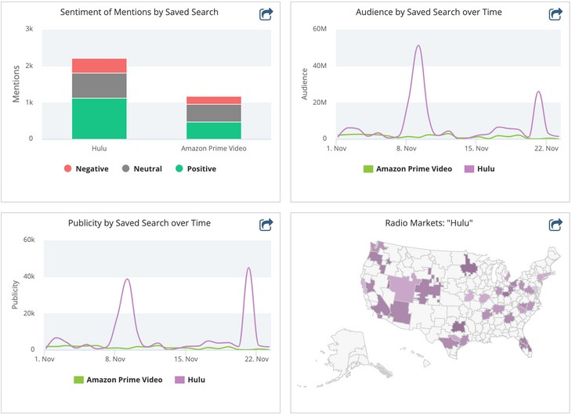
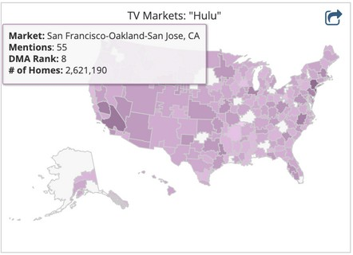



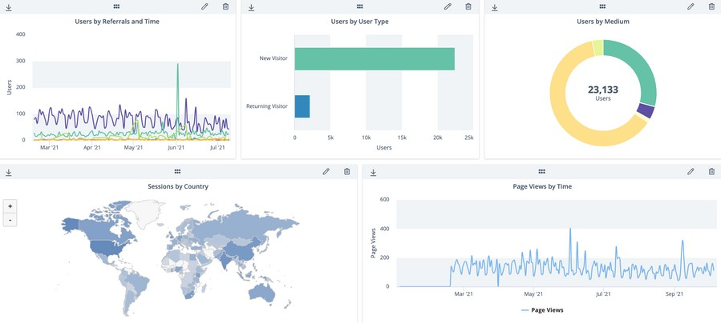
3
4
Promotion
Easy Analysis
Immediate Support
Feel confident knowing that client support is included with your subscription.
Building informative, clean, professional reports is intuitive and fast with
Critical Mention.
Every user is assigned a dedicated account manager to customize the platform and coverage to your exact specifications
Get help finding clips and maximizing the platform’s tools
Take advantage of unlimited training to ensure you get the most out of the platform
Your requested media contact changes will be vetted by human touch and updated within 24 hours
Contact our live support staff 24/7/365 to ask questions or request technical assistance
Gain essential insight by easily identifying sentiment and trends over time
Calculate your earned media with publicity value graphs and chart coverage on density maps and word clouds
Understand the context of your coverage with sentiment analysis, publicity value, share of voice and geographic breakdowns
Create reports with Google Analytics data, custom templates, graphs, charts and more
“I’ve tried other media monitoring services and Critical Mention is, by far, the most reliable and
convenient to use. Their customer service is impeccable and my
account manager always gets back to me immediately when I need
assistance or have questions.”
Ms. Micheal Widrig,
Public and Donor Relations Specialist, Shriner’s Hospital for Children
"After evaluating the competitive landscape for media monitoring tools, chose Critical Mention for its more robust functionality. Critical Mention offers PR analytics tools and access to coverage that many other platforms don’t provide, and which we need and use on a daily basis."
Stacy Jones,
Founder and CEO, Hollywood Branded
212.398.1141 www.criticalmention.com
www.criticalmention.com

