Slide 1
Methodology: America's Greatest Startup Workplaces 2025
New York
February 2025

Slide 2
From Newsweek’s Global Editor in Chief
In today's corporate landscape, diversity is a widely discussed topic. Employers highlight their commitment to recruiting and advancing individuals of various ages, races, genders, sexual orientations and abilities. Companies recognize that a diverse workforce contributes significantly to organizational success. Diverse workforces cultivate creativity and innovation that stem from a mix of perspectives, experiences, and backgrounds, fostering a dynamic environment where new ideas come to life.
While the attention on diversity has surged among companies, it can be challenging for job seekers, customers and potential partners to discern which organizations are genuinely dedicated to supporting a diverse workforce. In response, Newsweek and market data research firm Plant-A Insights Group are proud to present, for the first year, America's Greatest Startup Workplaces 2025, featuring the top mid-size companies recognized by their employees for genuinely respecting and valuing individuals from different walks of life.
Nancy Cooper
Global Editor in Chief

Slide 3
Leading the Way in Workplace Excellence and Exceptional Growth: Uncovering America’s Greatest Startup Workplaces 2025
Newsweek and Plant-A Insights Group has partnered to determine America's Greatest Startup Workplaces 2025.
"America's Greatest Startup Workplaces 2025" recognizes the top startups in the United States for their excellence in workplace culture and sustainable growth. The final rankings were based on Plant-A’s scoring model and study methodology, with the top 250 startups receiving the highest scores earning recognition as America’s Greatest Startup Workplaces 2025.
Our study involved a detailed analysis of publicly available data from 2,000 startups, each with a minimum of 50 employees. These companies were selected from an initial pool of 20,000 based on criteria such as employee count, funds raised, revenue segment, headquarters location, startup characteristics, and founding year.
We utilized multiple third-party data platforms to gather over 20 key performance indicators (KPIs) that provide insights into employee experience, the startup’s sustainability, and growth since its inception. These metrics reflect, employee satisfaction, operational growth, client engagement, investor confidence, and the startup’s future expansion plans.

Slide 4
Ensuring Only Startups with Sustainable Growth and Impact Make the Final List
Qualifying criteria
Ranking criteria
Initial long list of ~20K US based companies
Employee Satisfaction
Operational Growth
Average Employee Satisfaction Ratings
Average Recommendation Scores as an Employer
Long-term Headcount Growth
Average Headcount Added Per Year
Short-term Growth
Number of Job Openings as a Percentage of Total Current Headcount
Independent and Private
companies
Headquartered in US
Founded post 2019
~2,000 Companies Qualified for Ranking
Financial Strength
Client Engagement Growth
PROJECT
TITLE HERE
Total Funding Raised
Number of Funding Rounds
Average Funding Rounds per year
Revenue Range
Monthly Traffic Web Growth
Average Webpage Visit Duration
Page Views Per Visits and Bounce Rates
Employs at least 50 individuals
Min. Funding or Revenue:
>$10 Million

Slide 5
Scoring model: America's Greatest Startup Workplaces 2025
Project Scoping
1
Employee Satisfaction
2
Operational Growth
3
Financial Strength
4
Client/User
Engagement Growth
5
Media Monitoring, Validation
6
Our research included an in-depth analysis of more than 20 KPIs gathered from third-party platforms and publicly available databases, focusing on 2,000 startups with at least 50 employees. These 2,000 startups were selected from an initial pool of ~20,000 companies.
These included factors such as a minimum employee count, a certain threshold of funds raised, and the founding year, ensuring that only startups with the potential for sustainable growth and impact were considered for the final selection
Indicates employee satisfaction and engagement, which drives productivity, loyalty, and a strong startup culture
Parameters include:
Average Employee Satisfaction Ratings
Average Recommendation Scores as an Employer
Indicates a startup’s growth in operations, workforce, and capacity, highlighting its scalability and resource management
Parameters include:
Long-term Growth: Analyzed average headcount growth since startup inception, indicating how the startup has scaled its operations
Average Headcount Added Per Year
Short-term Growth⁽¹⁾: Growth in employees over the last 6 months, signaling how quickly the startup has scaled its operations
Number of Job Openings as a percentage of Total Current Headcount:
Indicates a startup’s funding success and revenue potential, revealing stability, growth prospects, and investor confidence
Parameters include:
Total Funding Raised and number of Funding Rounds
Average Funding Rounds per year
Revenue
Evaluates a startup’s ability to attract and retain customers, reflecting interest, satisfaction, and engagement for long-term success
Parameters include:
Monthly Traffic Web Growth
Average Webpage Visit Duration
Page Views Per Visits and Bounce Rates
The Critical Mention media monitoring platform from Onclusive was used to check if startups were linked to unfair practices from February 11, 2023, to February 11, 2025. startups identified with such issues were excluded from the final ranking
The validation process added extra scrutiny, with Plant-A research and Newsweek editorial teams reviewing the results for accuracy. Adjustments were made only when discrepancies were found and could be verified.
35%
15%
30%
20%
Final Score =
35%
x
Employee satisfaction score
+
15%
x
Operational growth
score
+
30%
x
Financial Strength score
+
20%
x
Client engagement growth score
Note: For Operational Growth, Financial Strength, and Client Engagement Growth metrics, we calculated an average score using an industry deviation model. We then applied these deviation scores to create a metric highlighting how a startup performs relative to the industry average.
(1) Short-term headcount growth: This was calculated based on the last 6 months. For startups lacking 6-month headcount data, we used the most recent headcount within the past 20 months, adjusted it to the 6-month period, and then calculated the growth.

Slide 6
Review and Evaluation
Media Monitoring
Data Validation & Final Ranking
For our media monitoring project, we utilized the tool Critical Mention, an Onclusive company. Onclusive is a world leader in media intelligence technology and services dedicated to supporting PR, Communications, and Marketing professionals.
Discrimination / Harassment: Utilizing Critical Mention to ensure that there are no pervasive public allegations.
Workplace Conditions: Verify that there are no pervasive public lawsuits.
Sustainability: Verify that there is public information about ongoing positive environmental engagement.
We used a variety of keywords to screen the press coverage of the last 24 months (February 11, 2023 – February 11, 2025).
The final rankings were calculated based on Plant-A’s scoring model and study approach.
Top 250 startups with the highest scores were recognized as America's Greatest Startup Workplaces 2025.
Plausibility check: Newsweek and Plant-A have reviewed all results and lists before publishing to avoid errors and add an additional layer of scrutiny.

Slide 7
Startups were grouped into 35 industries
Ranking
Retail
Entertainment Providers
Education
Wholesale
Healthcare
Hospitality
Construction
Repair and Maintenance
Real Estate
Printing Services
Civic and Social Organizations
Rental and Leasing
Book and Periodical Publishing
Manufacturing
Nanotechnology Research
Electric Power Transmission, Control, and Distribution
Mining, Quarrying, and Oil and Gas Extraction
Utilities
Agriculture, Forestry, Fishing and Hunting
Food Production
Architectural Services
Professional Services
Financial Services
Transportation, Logistics, Supply Chain and Storage
Transportation
Airlines and Aviation
Non-Profit Organizations
Staffing and Recruiting
Warehousing and Storage
Packaging and Containers
Energy, Resources and Industrials
Financial Services and Business Services
Consumer Services
Software Development
Technology, Information and Media
Judaical and Bureaucratic
Military and International Affairs
Public Policy Offices
Technology, Media and Telecom
Public Administration

Slide 8
Are you on the list? Great job, and Congratulations! Utilize your performance and license the badge.
Examples on how companies use recognitions
Email Footer
Recruiting Pages
Homepage
Videos & Presentation
Social Media
Media & Press Kit
Questions about the project and licensing opportunities?
Use Newsweek's America's Greatest Startup Workplaces 2025 Logo for your corporate e-mail signatures to showcase your
achievement to
Clients
Applicants Customers
Business partners and many more.
Use Newsweek's America's Greatest Startup Workplaces 2025 Logo for your:
Recruitment pages
Job offers
And profiles
To convince applicants, prospects and
stakeholders to become
a part of your startup and work culture.
Use Newsweek's America's Greatest Startup Workplaces 2025 Logo for your homepage to showcase our achievements to
Investors
Clients
Applicants
Customers
Partners
Use Newsweek's America's Greatest Startup Workplaces 2025 Logo for:
Television Ads NPR and Podcasts
VOD
Presentations
In order to reach your target group, the best possible way
Use Newsweek's America's Greatest Startup Workplaces 2025 Logo on your social media profiles
Instagram
YouTube
Twitter
Facebook
Use Newsweek's America's Greatest Startup Workplaces 2025 Logo for press releases and media kits to :
Increase awareness
Achieve higher accessibility
Show the impact on the work culture of your startup
Inquiries about licensing and pricing:
Licensing@plant-a.com
or
Americas.Greatest.Workplaces@Newsweek.com
Inquiries about the study / individual analysis
Research@plant-a.com

Slide 9
Disclaimer
Rankings Placement
Placement in the Rankings (defined below) is a positive recognition based on research of publicly available data sources from the time period in question.
Intellectual Property Rights All content within the rankings ("Rankings") is the exclusive property of Plant-A Insights Group LLC (“Plant-A”). This work, including all data, analyses, and derived rankings, is copyrighted under United States and international copyright laws. Unauthorized use, including but not limited to the publication, reproduction, modification, distribution, transmission, or display of any material without the prior written consent of Plant-A, is strictly prohibited.
Nature of the Rankings The Rankings are prepared by Plant-A and reflect an editorial content piece, based on both primary and secondary market research. This includes publicly available data and specific data provided directly to Plant-A. These Rankings are published in conjunction with Newsweek and should be viewed as an editorial work, not as definitive financial or business guidance.
Data Accuracy and Periodicity The Rankings are generated from data sources deemed reliable and are formed based on a methodological analysis of such data spanning the last 24 months. They are inherently a reflection of historical data and may not include subsequent developments, unforeseen events, or additional data not covered during the research period.
No Endorsement or Quality Assurance Plant-A does not endorse nor validate the business practices or the standing of the ranked companies. The inclusion or exclusion of any startup in the Rankings should not be used as a basis for investment, business, or other decisions. All decisions based on any information presented in the Rankings should be made in conjunction with other available information and independent advice.
Disclaimer of Liability Plant-A, its subsidiaries, and their respective officers, directors, employees, and agents (collectively, the "Plant-A Parties") disclaim all liability and responsibility for any errors or omissions in the Rankings or for any actions taken based on the contents of this publication. Neither Plant-A nor Newsweek guarantees the completeness or accuracy of the information contained in the Rankings.
By accessing, using, or relying upon the Rankings, you waive all claims and have no recourse against Plant-A Parties for any alleged or actual infringements of any rights of any party, including privacy rights, proprietary rights, intellectual property rights, rights of publicity, rights of credit for material or ideas, or any other rights, including the right to approval of uses such as copy that may be deemed to be distorted, derogatory, or offensive.
This disclaimer is intended to be as broad and inclusive as permitted under the law. If any portion hereof is held invalid or unenforceable, the remainder of the disclaimer shall nonetheless remain in full force and effect. This disclaimer constitutes the entire agreement between you and Plant-A regarding the use of the Rankings.
Copyright © 2025 Plant-A Insights Group LLC. All rights reserved.

Slide 10
Imprint
Plant-A Insights Group LLC
For any questions and requests:
Contact@plant-a.com
Authors: Plant-A Insights Group
Sources & Partner U.S. census 2024, Company websites, Aniline, Crunchbase, Critical Mention, an Onclusive company, various Social Media platforms
Image rights: iStock

Slide 11
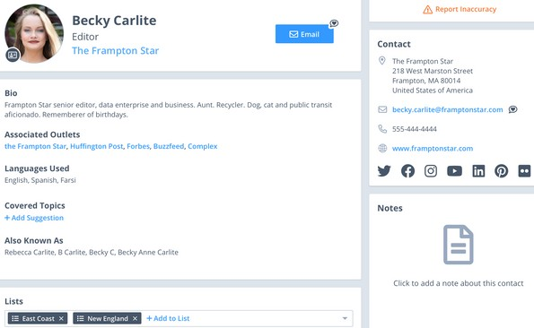
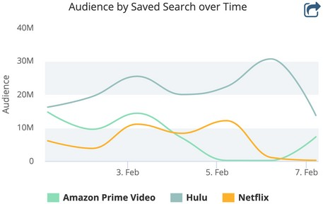
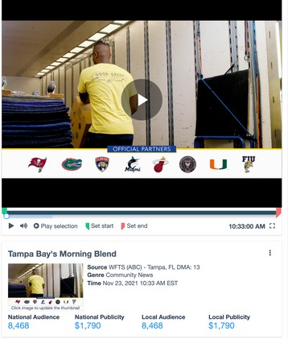
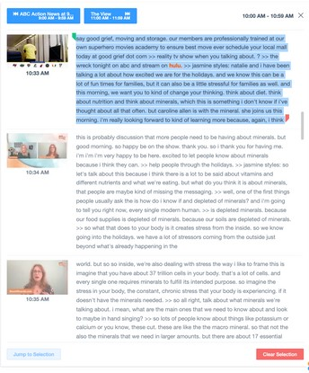
1
Promotion
Leading Technology
Easily access news coverage and media contacts information.
Overview 2022
Leverage our leading capture network to get more coverage in the U.S. & Canada than with any other provider
T R A C K . M E A S U R E . S H A R E . G R O W .
Get insights that matter with an intuitive, mobile-friendly interface and unlimited ad-hoc searching across TV, radio, online news, social media, licensed content (behind paywalls) and podcasts
Automate everyday tasks with saved searches, real-time alerts, & email digests
The Critical Mention Earned Media
Suite includes the fastest, most reliable real-time media monitoring tools,
robust analytics and most accurate
and frequently updated media contact database in the industry.
PR and communications pros use Critical
Mention to track, measure, share and grow earned media coverage. Monitor all of your mentions in real-time across TV, radio, online news, licensed content, podcasts, YouTube,
Twitter, Instagram and Facebook to get a clear picture of your coverage. Build
customized reports with analytics such as
share of voice, geographic coverage trends, mentions over time, sentiment analysis,
publicity values and Google Analytics data and charts integrated into the platform.
Access more than a million records with Critical Mention's Media
Contact Database, including social media profiles and pitching
information for reporters,
bloggers, producers, editors and social media influencers. Looking for the best support in the
industry? Your dedicated account manager is on call 24/7/365.
Utilize the media contact database to target journalists by location/designated market area (powered by Google), topic data, job title and more
2
Instant Sharing
Direct links from the Media Contact Database to contact's recent Broadcast and Online News stories
Download HD broadcast and YouTube clips, and podcast clips in real-time
Use our Wordplay technology to refine HD broadcast and podcast clips down to the micro-second
Take advantage of unlimited cloud storage to save important coverage you can revisit at any time
40
2K
Global TV and radio sources; more content in the U.S. and Canada than anyother provider
HOURS
Video content captured every minute
Licensed content, online
newspaper, magazine, trade publications, forum and blog pages
Comprehensive coverage of
the leading social media platforms
Get access to 1+ million records and pitching information
Access text transcription and edit clips of
top podcast mentions
This week alone , Critical Mention's monitoring has saved my team twice by providing lightning-fast alerts on some important news we were waiting for.
- Caroline Coons, Jelly Marketing
212.398.1141 www.criticalmention.com

Slide 12
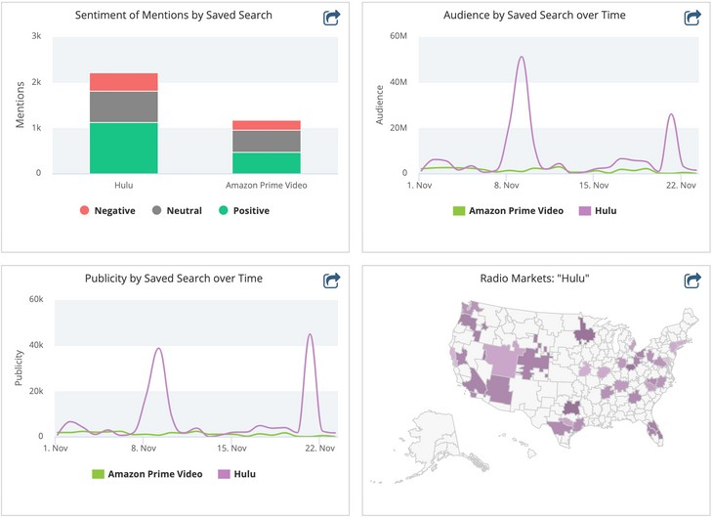
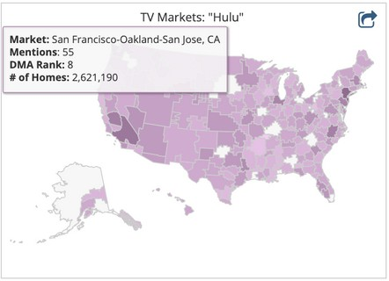
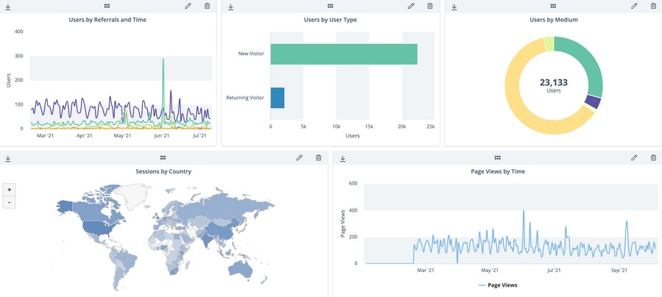
3
4
Promotion
Easy Analysis
Immediate Support
Feel confident knowing that client support is included with your subscription.
Building informative, clean, professional reports is intuitive and fast with
Critical Mention.
Every user is assigned a dedicated account manager to customize the platform and coverage to your exact specifications
Get help finding clips and maximizing the platform’s tools
Take advantage of unlimited training to ensure you get the most out of the platform
Your requested media contact changes will be vetted by human touch and updated within 24 hours
Contact our live support staff 24/7/365 to ask questions or request technical assistance
Gain essential insight by easily identifying sentiment and trends over time
Calculate your earned media with publicity value graphs and chart coverage on density maps and word clouds
Understand the context of your coverage with sentiment analysis, publicity value, share of voice and geographic breakdowns
Create reports with Google Analytics data, custom templates, graphs, charts and more
“I’ve tried other media monitoring services and Critical Mention is, by far, the most reliable and
convenient to use. Their customer service is impeccable and my
account manager always gets back to me immediately when I need
assistance or have questions.”
Ms. Micheal Widrig,
Public and Donor Relations Specialist, Shriner’s Hospital for Children
"After evaluating the competitive landscape for media monitoring tools, chose Critical Mention for its more robust functionality. Critical Mention offers PR analytics tools and access to coverage that many other platforms don’t provide, and which we need and use on a daily basis."
Stacy Jones,
Founder and CEO, Hollywood Branded
212.398.1141 www.criticalmention.com
www.criticalmention.com

